Slide 1

Rising incidence of diabetes in united states

Slide 2




team
Rayon King
Dominic Familette
Makenzie Eason
Jessica Guinn

Slide 3


Agenda
Age
Race
Gender
Diagnosed Data
Correlations
Death Rate
Summary
Conclusion of Project

Slide 4



Introduction
Our research delves into the intricate landscape of diabetes and its associated mortality rates, drawing insights from data compiled by the Centers for Disease Control and Prevention. With a focus on demographics statistics, we aim to establish correlations and uncover potential patterns to understand the impact of this growing health concern. Through our analysis of the provided data, we aim to contribute valuable insights into the complexity of diabetes-related deaths, and associated risk factors that may impact your chances of diabetes diagnosis.

Slide 5
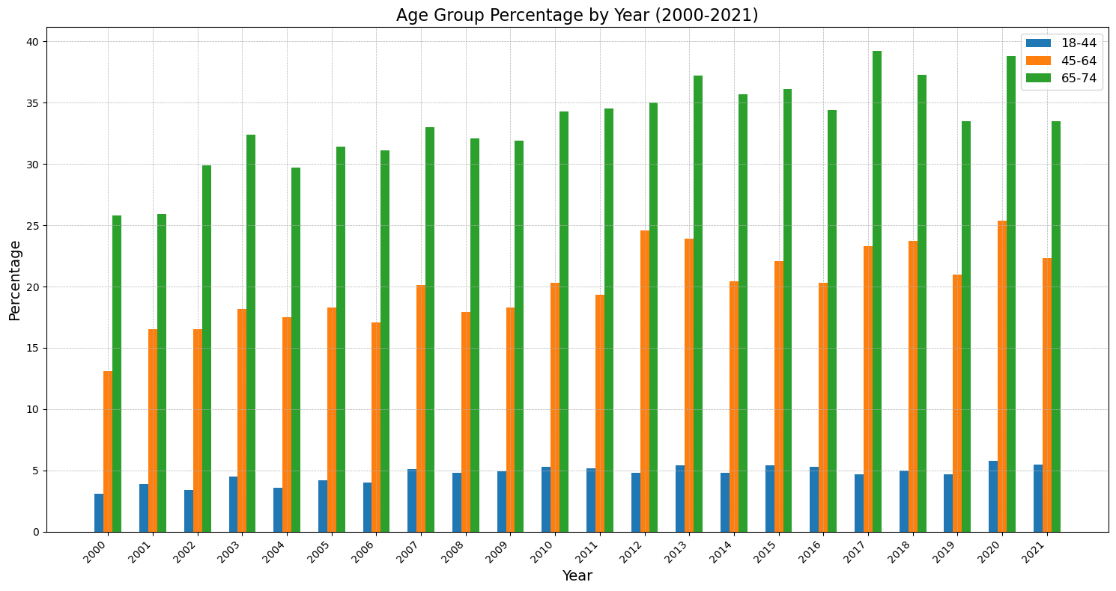
Age group by year analysis
The dataset collected contained age group percentages. This information shows us how the distribution population diagnosed with diabetes over time that has changed.
The 18-44 y.o. group had a sizeable increase over the years, rising from approximately 1.80% in 2000 to 3.22% in 2021. This suggests younger population health has been negatively impacted.
The 45-64 y.o. group has remained stable with moderate fluctuations over time.
The 65-74 y.o. group has had a gradual upward trend.

Slide 6
race
Asian populations have seen a 5.6% difference in diabetes rates
Diabetes is rising across all demographics
45-64 age group has remained stable with moderate fluctuations over time.
65-74 age group has had a gradual upward trend

Slide 7
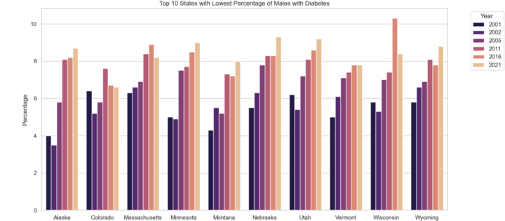
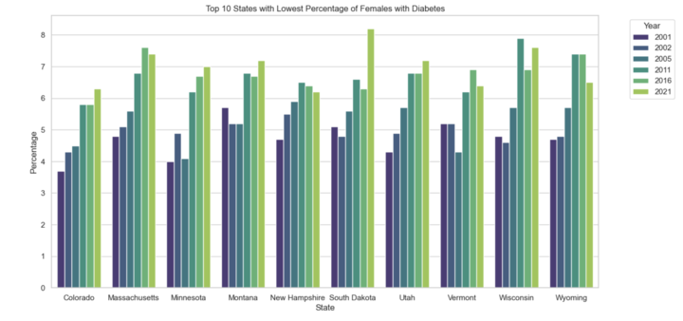
Top 10 States with Lowest Percentage of Males and Females with Diabetes
Colorado Massachusetts Minnesota Montana Utah Vermont Wisconsin Wyoming
Female Only
New Hampshire South Dakota
Male Only
Alaska Nebraska
State Correlations

Slide 8
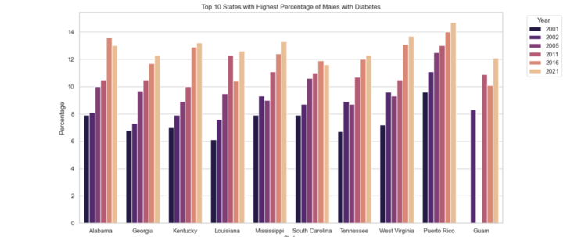
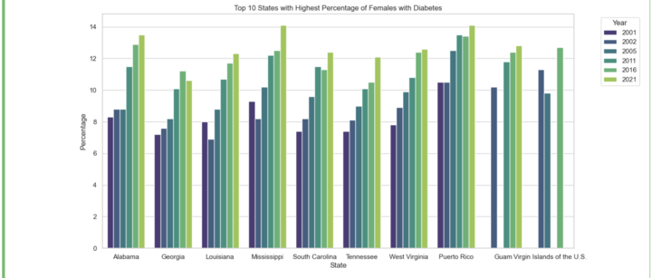
Top 10 States with Highest Percentage of Males and Females with Diabetes
Alabama
Georgia
Louisiana
Mississippi
South Carolina Tennessee
West Virginia
Puerto Rico
Guam
Female Only
Virgin Islands
Male Only
Kentucky
State Correlations

Slide 9

Any
The dataset collected contained age group percentages. This information shows us how the distribution population diagnosed with diabetes over time that has changed.
18-44 age group had an increase over the years, approximately 1.80% in 2000 to 3.22% in 2021. This suggests younger population health has been impacted in a negative manner.
45-64 age group has remained stable with moderate fluctuations over time.

Slide 10
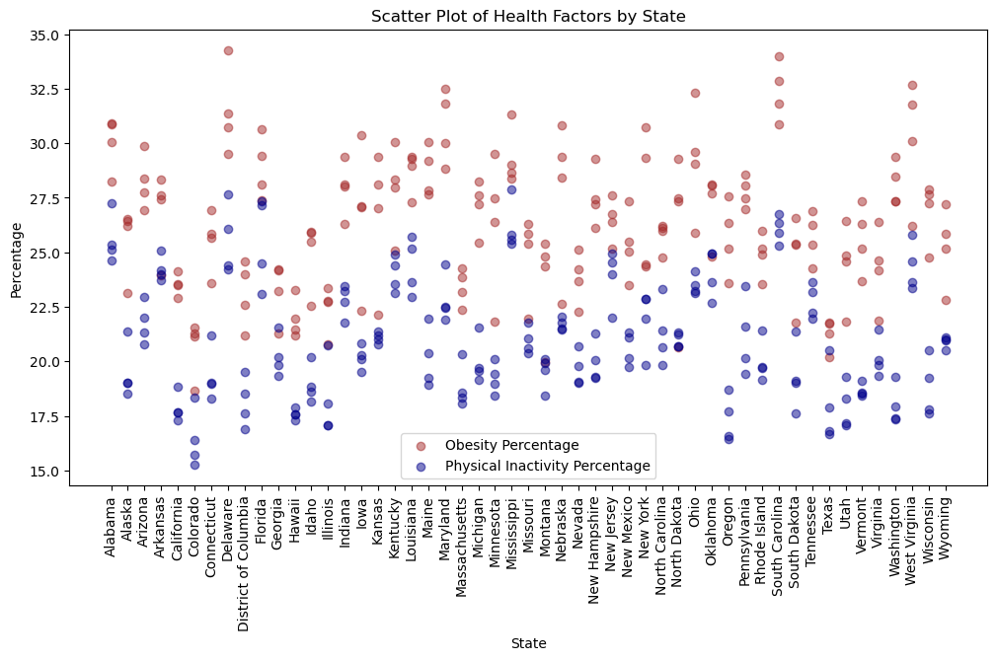
State Analysis
The dataset contains information on state diagnosis, obesity rate, and physical inactivity rates from the years 2010, 2014, 2016, and 2018.
Obesity rate and physical activity often correlate, as the obesity rate increased the physical activity tends to increase as well.
It is important to note that although obesity and physical activity correlate, they are not the same thing. Generally, states with a lower activity rate had a higher rate of obesity.
A further analysis would be needed to identify definitive conclusions on the differences and correlation of the two datasets. There are many factors to health statistics, including regional and demographic differences that my play a role in diagnosis rates.

Slide 11

correlations
Walt Disney
The elderly have significantly higher rates
Men have slightly higher rates than women

Slide 12
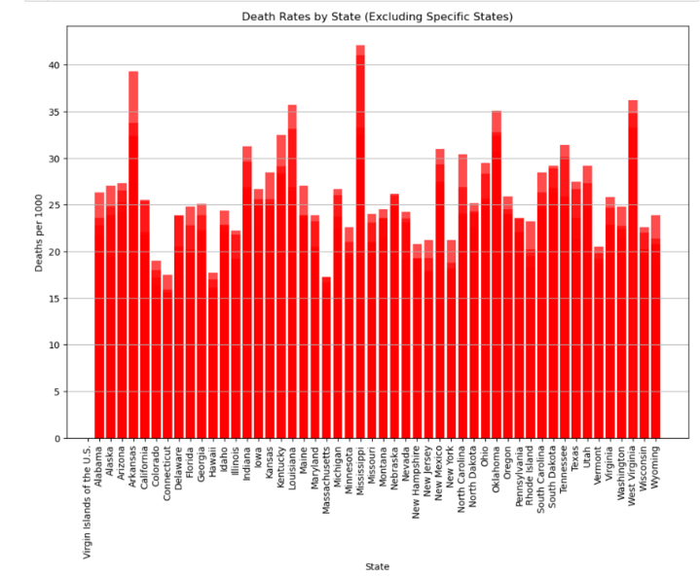
Death rates
This bar chart shows the affect diabetes has on mortality rates in America from 2012 to 2021.
As shown Mississippi, Arkansas, West Virginia are the top three states with the highest death rate percentages.
We were expecting to show a clear separation between southern and northern states. However, the data shows some somewhat even ranges between states.
The data shown paints a picture that is not just one diet type can lead to mortality but the American diet as a whole.

Slide 13




Summary
With PowerPoint, you can create presentations and share your work with others, wherever they are. Type the text you want here to get started. You can also add images, art, and videos on this template. Save to OneDrive and access your presentations from your computer, tablet, or phone.

Slide 14
Conclusion of project
Limitations
Complete years of data to combine datasets. Difficulty in comparing multiple demographics by state and years.
Limited information on dietary impacts for diabetes diagnosis.
Time constraints for finding and compiling datasets, datasets initially found did not benefit the analysis processes.
Lessons Learned
Finding better datasets to support additional analysis on nutrition, further demographics i.e. race, ethnicity, income, population etc.
The ability to have more time to engage in team project work, this could have resulted in a more in-depth scope of work.
More experience in working through GitHub and shared environments Git Push/Pull. Practicing in GitHub for constant changing environment and working within a team.

Slide 15
references
https://gis.cdc.gov/grasp/diabetes/diabetesatlas.html
https://www.cdc.gov/diabetes/data/statistics-report/index.html
https://www.cdc.gov/nchs/pressroom/sosmap/diabetes_mortality/diabetes.htm

Slide 16
Additional Content
Subtitle
Subtitle
Subtitle
Add text, images, art, and videos.
Add transitions, animations, and motion.
Save to OneDrive, to get to your presentations from your computer, tablet, or phone.
Open the Design Ideas pane for instant slide makeovers.
When we have design ideas, we’ll show them to you right there.
This PowerPoint theme uses its own unique set of colors, fonts, and effects to create the overall look and feel of these slides.
PowerPoint has tons of themes to give your presentation just the right personality.

Slide 17
Timeline
Title
To start a presentation, go to the Slide Show tab, and select From Beginning.
Title
To display Presenter view, in Slide Show view, on the control bar at the bottom left select the three dots, and then Show Presenter View.
Title
During your presentation, the speaker notes are visible on your monitor, but aren't visible to the audience.
Title
The Notes pane is a box that appears below each slide. Tap it to add notes.
Title
If you don’t see the Notes pane or it is completely minimized, click Notes on the task bar across the bottom of the PowerPoint window.

Slide 18
Table
 | Category 1 | Category 2 | Category 3 | Category 4
Item 1 | 4.5 | 2.3 | 1.7 | 5.0
Item 2 | 3.2 | 5.1 | 4.4 | 3.0
Item 3 | 2.1 | 1.7 | 2.5 | 2.8
Item 4 | 4.5 | 2.2 | 1.7 | 7.0

Slide 19
Table
 | Category 1 | Category 2 | Category 3 | Category 4
Item 1 | 4.5 | 2.3 | 1.7 | 5.0
Item 2 | 3.2 | 5.1 | 4.4 | 3.0
Item 3 | 2.1 | 1.7 | 2.5 | 2.8
Item 4 | 4.5 | 2.2 | 1.7 | 7.0

